Slide 1

SYLIP CORPORATION
ANNUAL SALES PERFORMANCE REPORT FROM 2010 - 2017
DATA TYPE: ANNUAL SALES DATA
REPORTING CYCLE: 2010 – 2017
PRESENTED BY
GROUP 2

Slide 2
GROUP NAME AND TEAM MEMBERS
Precious Gift
Sam Aiyere
Daniel Olatunde
Oluwakemi Iyodo
Folake Florence Oyegun
Samuel Obasi

Slide 3
BENCH-MARK – (Assumed Value)
Annual Total Cost Target = £ 1,500,000.00
Annual Total Profit Target = £ 2,500,000.00
Annual Revenue (Sales) Target = £ 3,000,000.00
Annual Units Sold (Qty) Target = 15,000 Units

Slide 4
KEY PERFORMANCE INDICATORS
Compute Total Profit from All Regions
Rate of Total Revenue Achieve in All Region
Determine the Gross Profit Margin for each items type sold
Top 4 countries with highest and lowest Revenue

Slide 5
TERMINOLOGIES
Total Revenue: This is the total amount of money generated from the sales of goods or services by a business within a specific period. It is calculated by multiplying the price per unit by the number of units sold. In formula terms, Total revenue (TR) is expressed as:
Total Revenue(TR)= price per unit * Quantity.
Total Profit: This is the financial gain a business achieves after subtracting all its cost and expenses from its total revenue. The formula for calculating total profit is :
Total Profit = Total Revenue – Total Cost

Slide 6
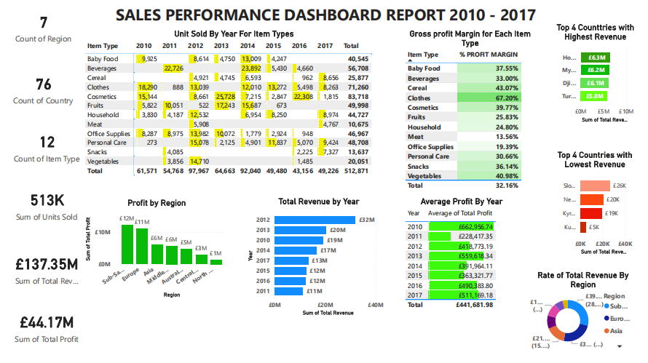

Slide 7
KPI 1: Total Profit from all regions
SUMMARY REPORT
For the period under review:
Total profit achieved for all Regions is £ 44,168,198.40
Sub-Saharan Africa achieved the Highest profit within the period under reviews(8years) with a total sum of £ 12,183,211.40

Slide 8
KPI 2:Rate of Total Revenue achieved Annually
SUMMARY REPORT
The Best performing region is Sub-Saharan Africa with 29% Annual Revenue.
North America derived the lowest, achieving a rate of 4%.

Slide 9
KPI 3: Gross Profit Margin for each items type sold
SUMMARY REPORT
The Item type with the Highest Gross profit Margin within the period under review is Clothes with a value of 67%
Meat had the lowest Gross profit Margin of 14%

Slide 10
KPI 4A: Top 4 Countries with Highest Revenue
SUMMARY REPORT
During the Period Under review Honduras achieved the Highest Revenue with the sum of £6,336,545.48

Slide 11
KPI 4B: Top 4 Countries with Lowest Revenue
SUMMARY REPORT
During the Period Under review the performance shows that Kuwait had the Lowest Revenue with the sum of £4,870.26

Slide 12
CONCLUSION
- The Annual Target for Total cost within the 8 years amounts to £12,000,000 mean while the actual expenses incurred was £70,183.931.73. This indicates 583.3% beyond the targeted Cost
-In view of the performance of slip corporation we can say the performance is favorable having realized 220% profit above the target for the 8 years
- The Total revenue realized within the purview of Eight years shows 572.3% above the Target Revenue . This is Fantastic and Favorable to the company performance
-Performance shows that the Total unit sold within the period under review was 427.9% above the Target which is good for the business hence leading to increased revenue and profit realized within the 8 Years
-
-

Slide 13
RECOMMENDATION
-Based on the out standing performance, we would advice that the business maintains its proactive measures in order to maintain a steady growth in revenue, Profit and customer Satisfaction
-However, the Four(4) Countries with the Lowest revenue need to improve in their marketing and advertising strategies so as to help drive more sales which will lead to growth in profit and boost the confidence of stakeholders.

Slide 14
THANK YOU

